Slide 1
Java - AWT
Lecture 30

Slide 2
Learning objectives:
After the completion of today’s session you will be able to:
Learn the basics of Java AWT and its hierarchy.
Define various terminologies in Java AWT environment.
Analyze frame class in Java AWT.
Explore components in AWT environment.
Implement Applet components

Slide 3
Introduction
Java AWT (Abstract Windowing Toolkit) is an API to develop GUI or window-based application in java.
Java AWT components are platform-dependent i.e. components are displayed according to the view of operating system.
AWT is heavyweight i.e. its components uses the resources of system.
The java.awt package provides classes for AWT api such as TextField, Label, TextArea, RadioButton, CheckBox, Choice, List etc.
It is important to state at the outset that you will seldom create GUIs based solely on the AWT because more powerful GUI frameworks (Swing and JavaFX) have been developed for Java.

Slide 4
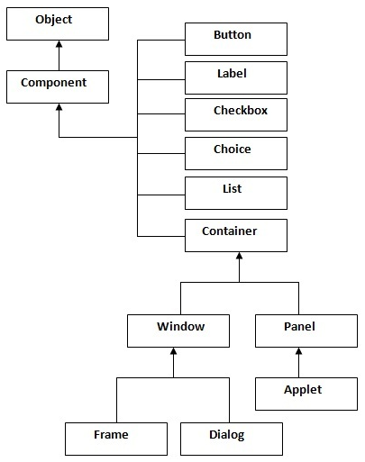
Java AWT hierarchy

Slide 5
AWT classes
Page 852 of - Java: The complete Reference – 12th edition

Slide 6
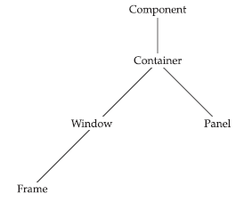
Window Fundamentals

Slide 7
Component
At the top of the AWT hierarchy is the Component class.
Component is an abstract class that encapsulates all of the attributes of a visual component.
Except for menus, all user interface elements that are displayed on the screen and that interact with the user are subclasses of Component.
It defines over a hundred public methods that are responsible for managing events, such as mouse and keyboard input, positioning and sizing the window, and repainting.
A Component object is responsible for remembering the current foreground and background colors and the currently selected text font.

Slide 8
Container
The Container class is a subclass of Component.
It has additional methods that allow other Component objects to be nested within it.
Other Container objects can be stored inside of a Container (since they are themselves instances of Component).
This makes for a multileveled containment system.
A container is responsible for laying out (that is, positioning) any components that it contains.
It does this through the use of various layout managers.

Slide 9
Panel
The Panel class is a concrete subclass of Container. A Panel may be thought of as a recursively nestable, concrete screen component.
Panel is the superclass for Applet. When screen output is directed to an applet, it is drawn on the surface of a Panel object.
In essence, a Panel is a window that does not contain a title bar, menu bar, or border. This is why you don’t see these items when an applet is run inside a browser.
When you run an applet using an applet viewer, the applet viewer provides the title and border.
Other components can be added to a Panel object by its add( ) method (inherited from Container).
Once these components have been added, you can position and resize them manually using the setLocation( ), setSize( ), setPreferredSize( ), or setBounds( ) methods defined by Component.

Slide 10
Window
The Window class creates a top-level window.
A top-level window is not contained within any other object; it sits directly on the desktop.
Generally, you won’t create Window objects directly.
Instead, you will use a subclass of Window called Frame.

Slide 11
Frame
Frame encapsulates what is commonly thought of as a “window.”
It is a subclass of Window and has a title bar, menu bar, borders, and resizing corners.
The precise look of a Frame will differ among environments.
Frames can be implemented either through inheritance or association.

Slide 12
Canvas
Although it is not part of the hierarchy for applet or frame windows, there is one other type of window that you will find valuable: Canvas.
Derived from Component, Canvas encapsulates a blank window upon which you can draw.

Slide 13
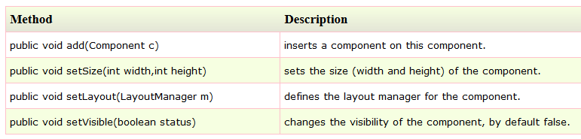
Useful Methods of Component class

Slide 14
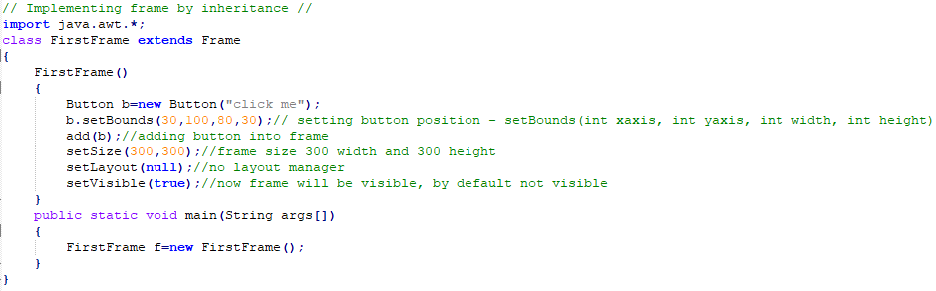
Frames Example by inheritance:

Slide 15
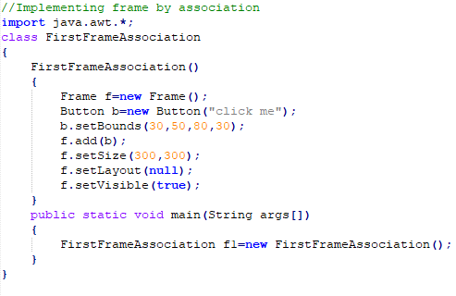
Frames Example by Association:

Slide 16
AWT Components:
The AWT supports the following types of controls:
Labels
Buttons
Check boxes
Choice
Lists
Others like TextArea, TextField, CheckBoxGroup
These controls are subclasses of Component. Although this is not a particularly rich set of controls, it is sufficient for simple applications.

Slide 17
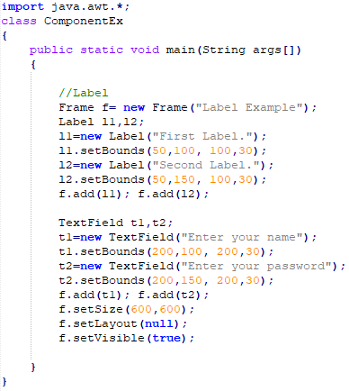
Example

Slide 18
Reference
Java: The complete Reference by Herbert Shieldt
https://www.javatpoint.com/java-awt

Slide 19
Thanks

